Slide 1
Templates and the Standard Template Library
Part I

Slide 2
Templates
For ADTs it is the manner in which the data is stored (rather than the precise type of data stored)
The mechanism supporting genericity in C++ is the template construct.

Slide 3
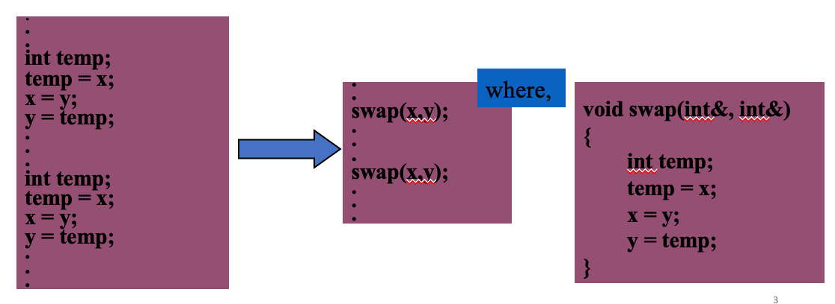
Function Genericity
Let’s say we want to swap the value of two integers ‘x’ and ‘y’
Few possible approaches:
  Write inline code
  Make the inline code into a function

Slide 4
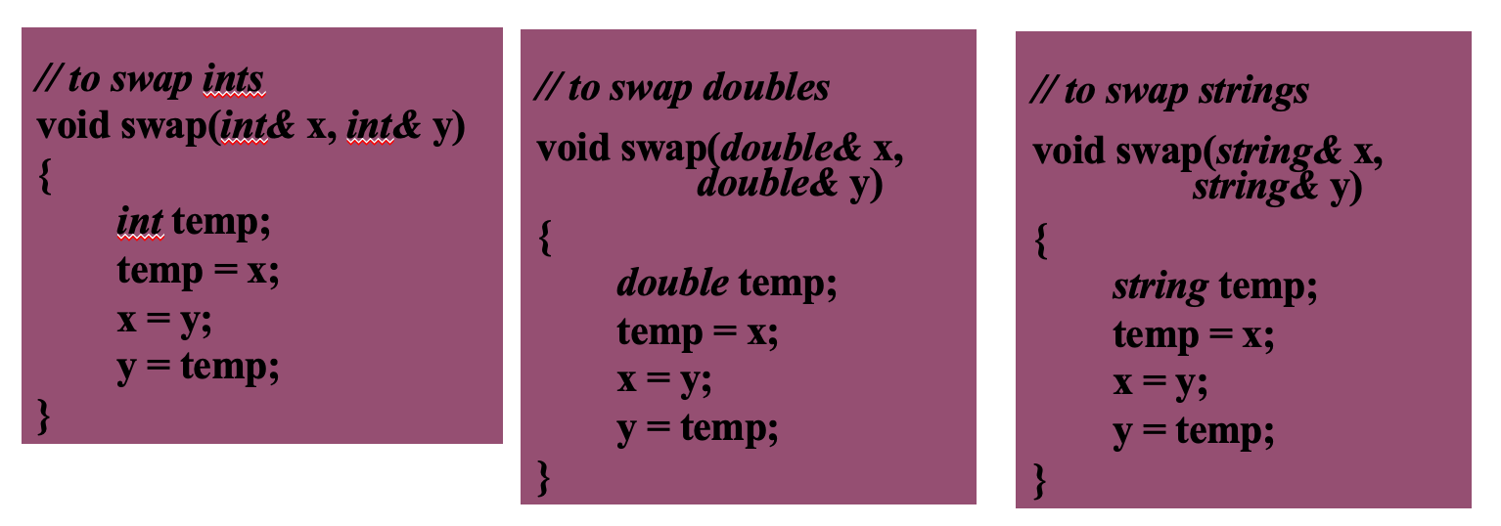
Function Genericity
Similarly, we can write any overloaded function to swap two strings or any other ADTs
A point to note is that the destructor, copy constructor and the assignment operator ‘=‘ should be defined/overloaded for the user defined ADTs specially if they member variables that are pointers.

Slide 5
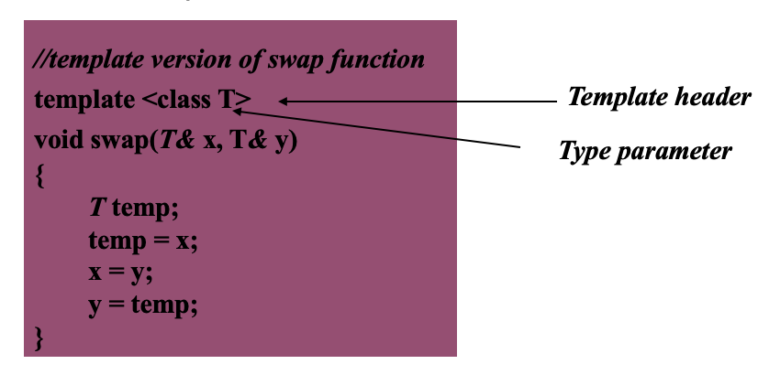
Function Genericity
The next stage then is to replace the data type with a placeholder. This placeholder is termed a type parameter and the technique/mechanism used is called a template function.

Slide 6
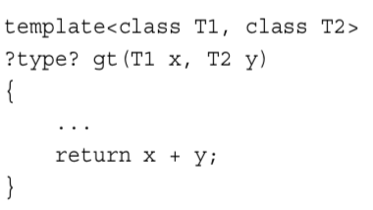
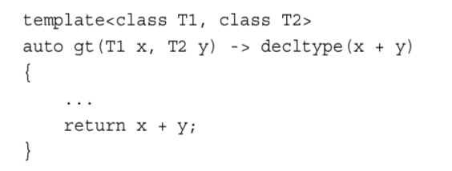
New to C++ 11
The decltype Keyword
  int x,y;
  decltype(x+y) xy = x + y
Alternative Function Syntax – Trailing Return Type

Slide 7
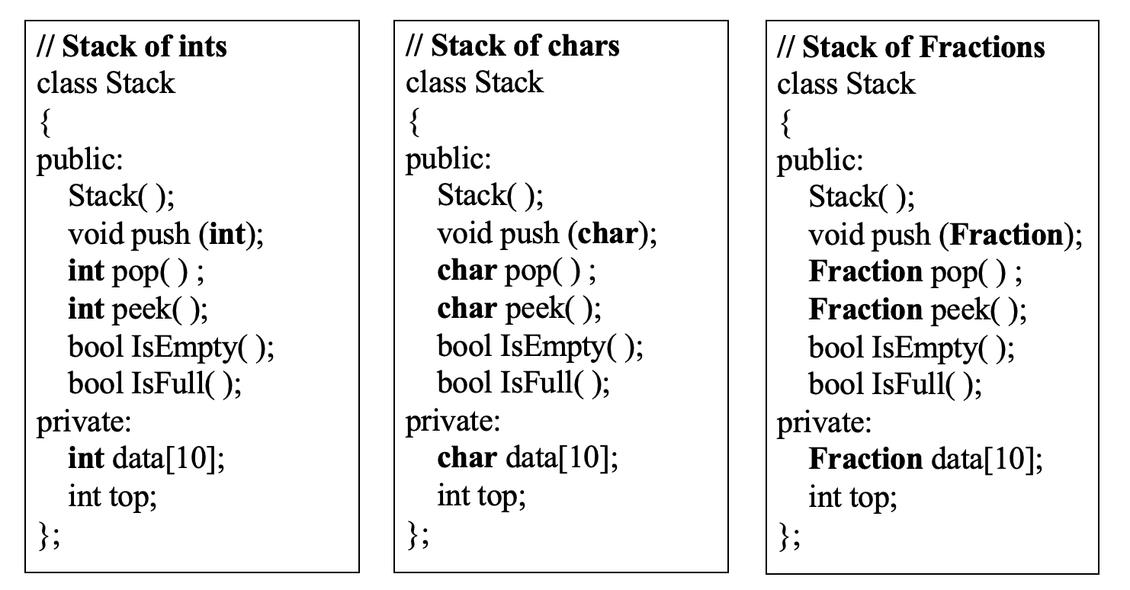
Class Genericity
Using ordinary classes

Slide 8
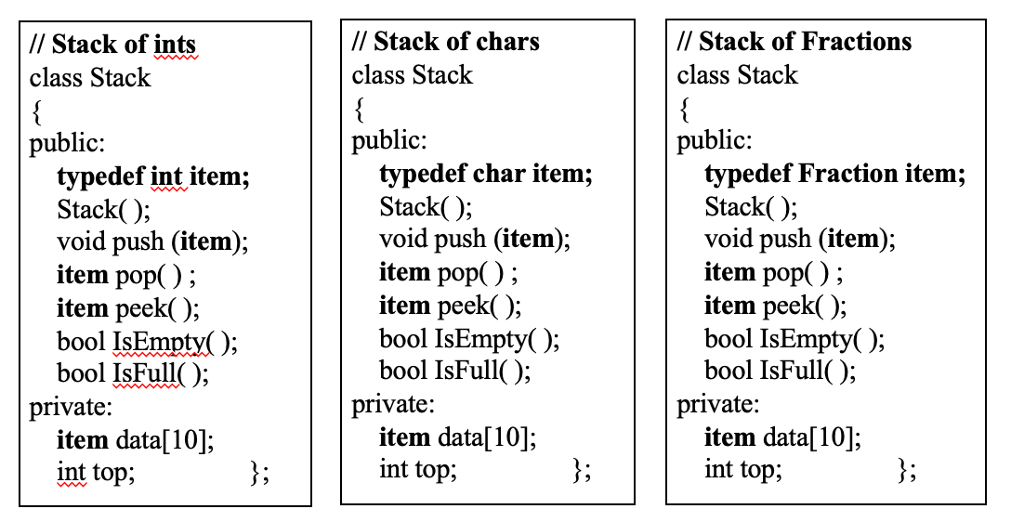
Class Genericity
Using a typedef statement in class definition
reduces amount of code to modify

Slide 9
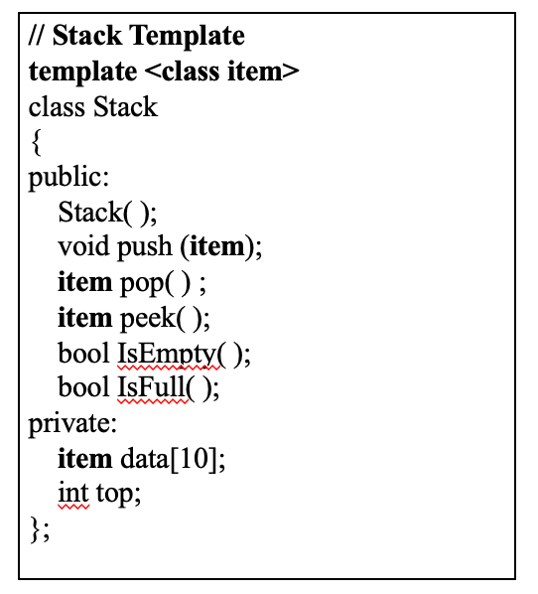
Class Genericity
Using a template class

Slide 10
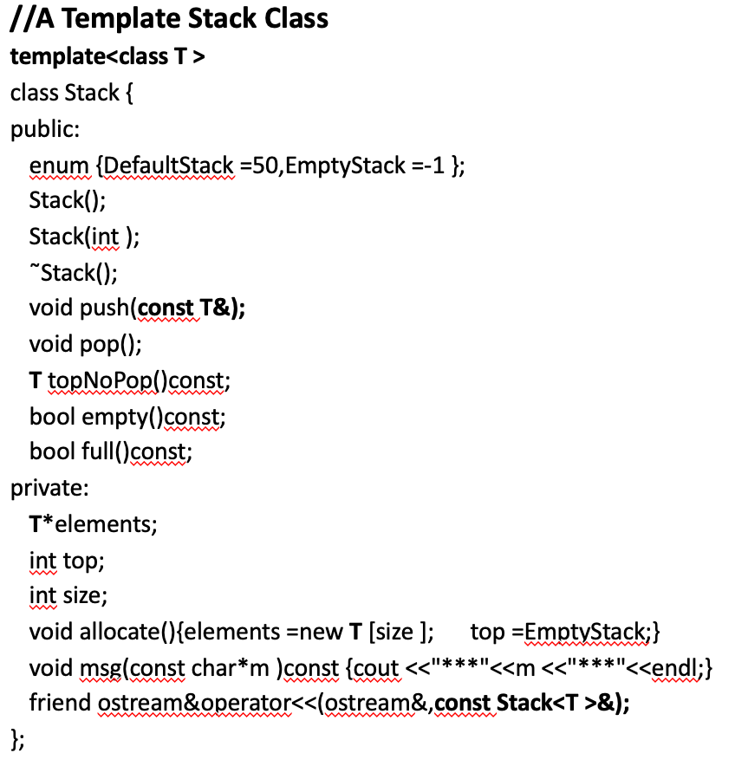
Stack Program using Dynamic Array

Slide 11
template<class T >
Stack<T >::Stack(){size =DefaultStack; allocate(); }
template<class T >
Stack<T >::Stack(int s ){if (s <0) s*=-1;
else if (s==0 ) s =DefaultStack;
size =s; allocate(); }
template<class T >
Stack<T >:: ˜Stack(){delete []elements;}
template<class T >
void Stack<T >:: push(const T&e ){assert(!full());
if (!full())elements [++top ]=e;
else msg("Stack full!");}
template<class T >
void Stack<T >::pop(){assert(!empty());
if (!empty()) top--;
else { msg("Stack empty!");}}
Contd.

Slide 12
template<class T >
T Stack<T >::topNoPop()const {assert(top >EmptyStack );
if (!empty())return elements [top ];
else {msg("Stack empty!");
T dummy_value; return dummy_value;}}
template<class T >
bool Stack<T >::empty()const {return top <=EmptyStack;}
template<class T >
bool Stack<T >::full()const {return top +1>=size;}
template<class T >
ostream&operator<<(ostream&os,const Stack<T >&s ){
s.msg("Stack contents:");
int =s.top;
while (t>s.EmptyStack )cout <<s.elements [t--]<<endl;
return os;}

Slide 13
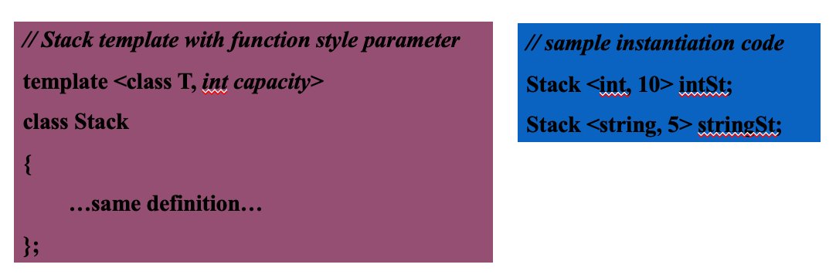
Class Genericity
  In addition to at least one class parameter (can be more than one), a template class can also use a function style parameter.
  The function style parameter ‘capacity’ in the following implementation of the stack class allows the user to specify the size of the stack at the time of instantiation.

Slide 14
Summary
Templates make it possible for classes and functions to receive not only data values to be stored or operated on via parameter but also to receive the type of data via a parameter.
01
Templates go a long way in creating generic code and promoting code reuse.
02

